Slide 1


Presented by Rishit Rastogi
Unleashing the realm of predictive maintenance based solution:
Machine Failure Classification
YouTubeLink: https://youtu.be/f1-WWHE4rbA
DataSet Link: https://drive.google.com/file/d/1V4ZK4LGYCQ7FiQXavGaSOiwUGPoy9GNB/view?usp=sharing
For Full Hands on Software demonstration

Slide 2

Methodology used in the analysis
1)Importing Data: The process begins with importing the dataset into a data analysis tool or programming environment like RapidMiner. This step involves loading the data from its source, such as a database or a file.
2)Data Cleaning: After importing the data, the next step is to clean it. This involves identifying and handling missing values, duplicates, and any other inconsistencies in the data. Cleaning the data ensures that it is of high quality and suitable for analysis.
3)Data Analysis:Doing suitable analysis on cleaned data for feature eningneering ,target selcetion and beter understating of data for model selection too

Slide 3


Overview of RapidMiner
Unified Platform: Collaborative environment for data scientists, engineers, and analysts.
Generative AI: Easy model creation without complexity.
Data Preparation: Automates data cleaning and transformation through process deign feature by simply dragging and dropping the requirement
Streamlined Model Creation: Simplifies training, evaluation, and deployment.

Slide 4
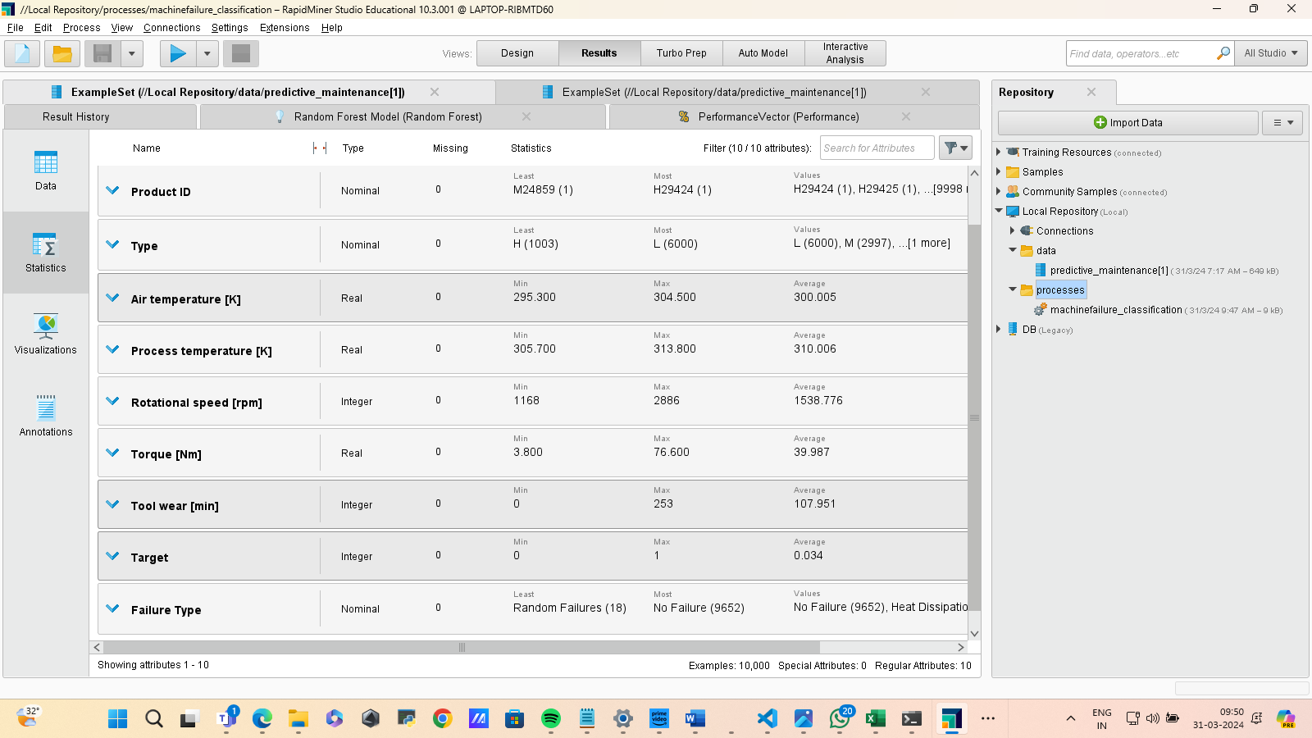
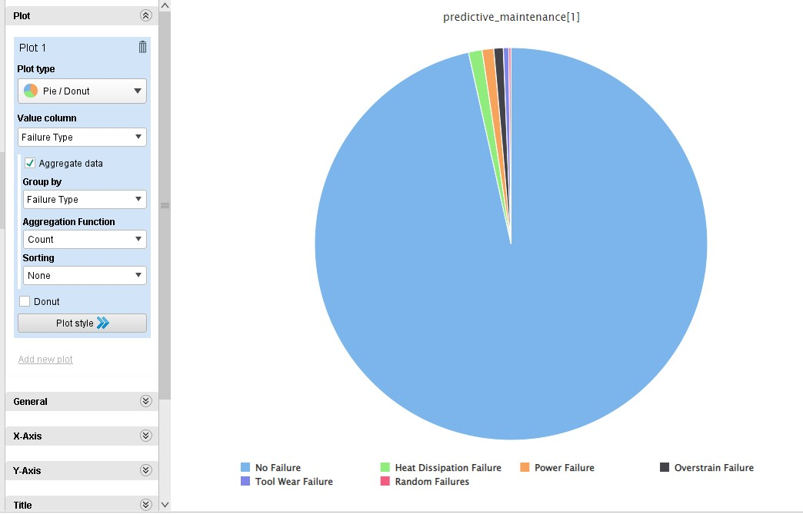
Data Analysis Result

Slide 5
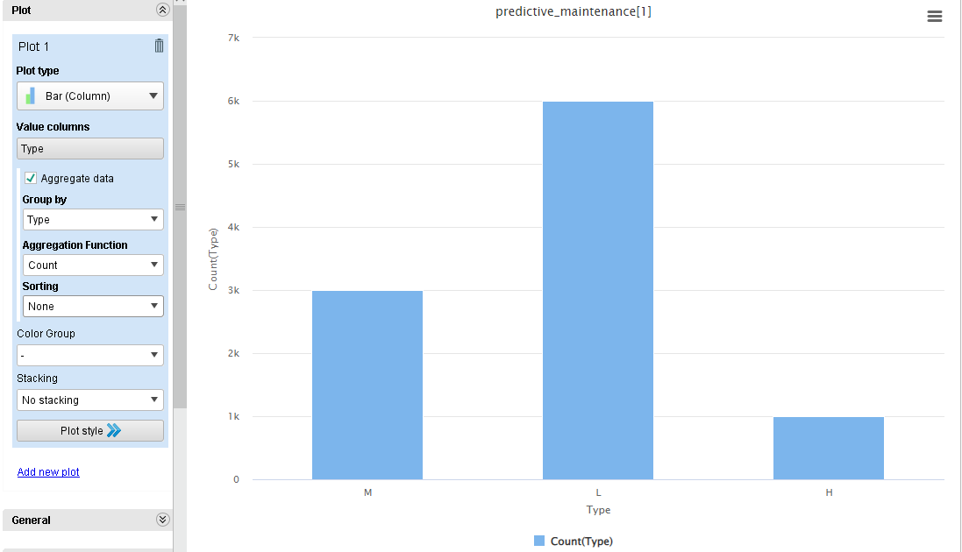
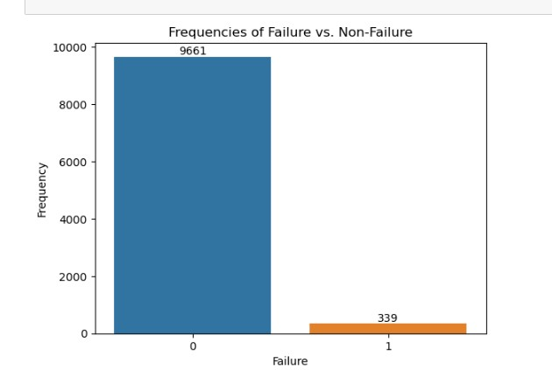
Data Analysis Result

Slide 6
4)Data Processing: Once the data is cleaned, it may need further processing to make it suitable for analysis. This could include tasks such as converting categorical variables into numerical representations like failure type , dealing with outliers like scaling of data as there is imbalance between non failure and failure of machine data, and handling any other data transformations like product ID and UID (unique identifier) may not contribute to predicting machine failures and can be removed to simplify the model and improve its performance.
5)Data Splitting: Divide the dataset into a 70% training set and a 30% testing set to train and evaluate the model
.
6)Model Selection: Choose a suitable model for failure classification, such as Random Forest with 100 trees, known for its robustness and accuracy.
7)Model Training: Train the Random Forest model on the training dataset to learn patterns and relationships between features and failure types.

Slide 7
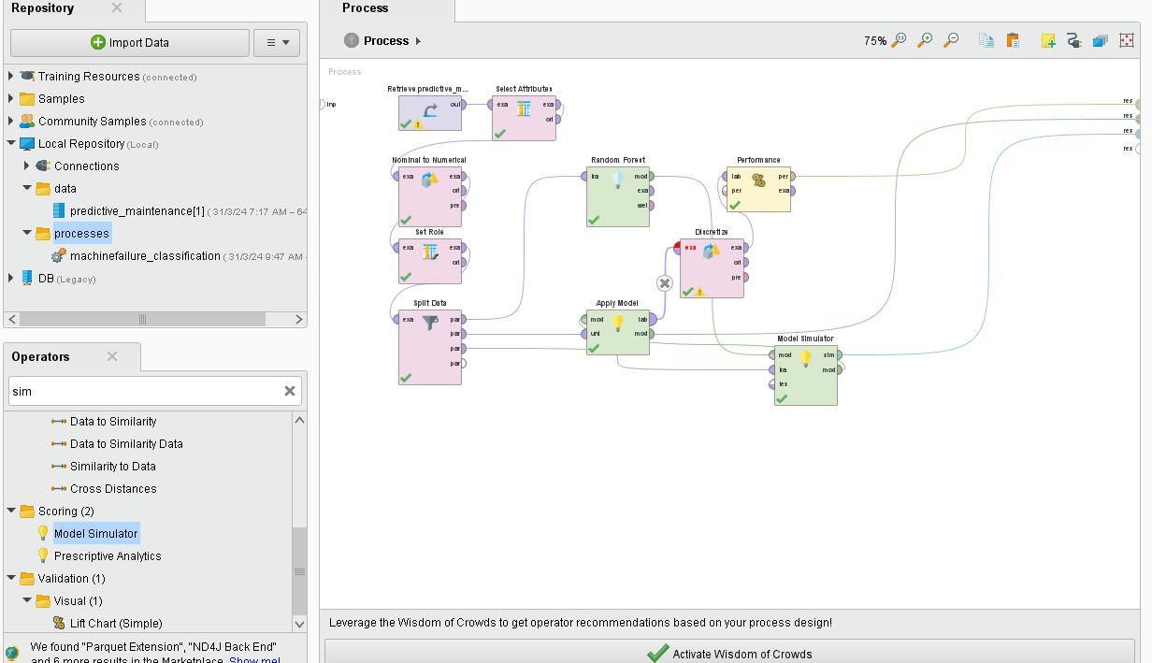
Process Design Layout

Slide 8
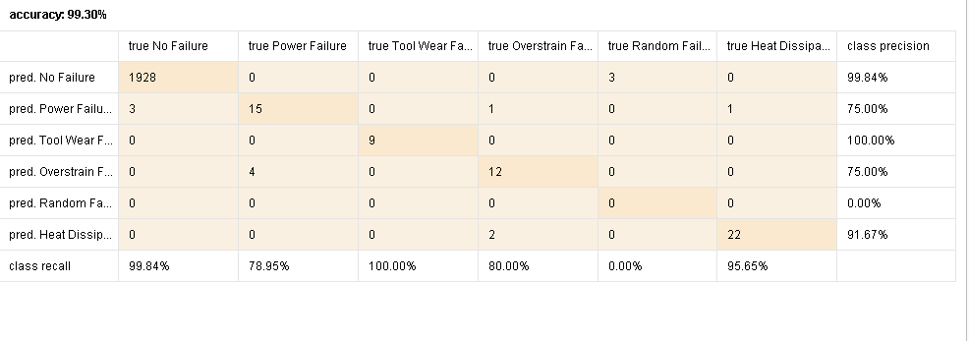
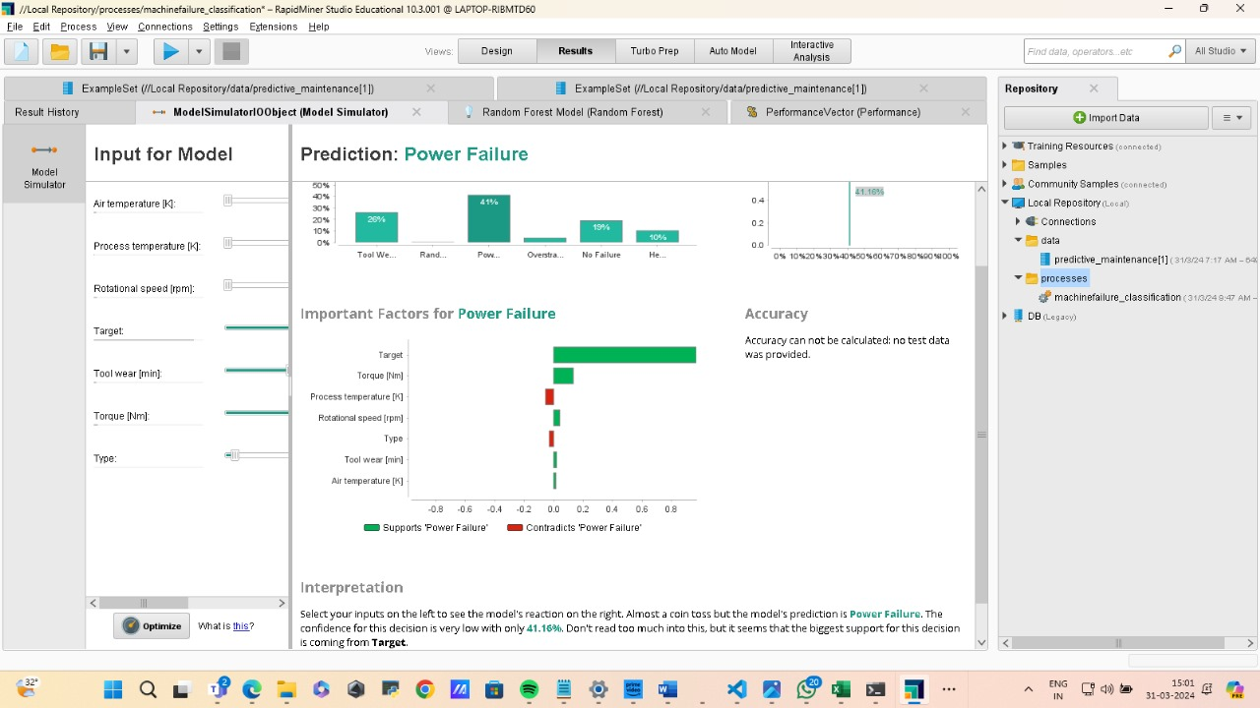
8)Model Evaluation: Evaluate the trained model's performance on the testing dataset using metrics like accuracy, precision, recall, and F1-score.
9)Confusion Matrix: Plot the confusion matrix to visualize the model's performance in classifying different types of failures.
10)Performance Classification Report: Generate a classification report summarizing the model's performance metrics, showcasing its accuracy and effectiveness in failure classification.
Performance Classification Report:
Model Simulation

Slide 9
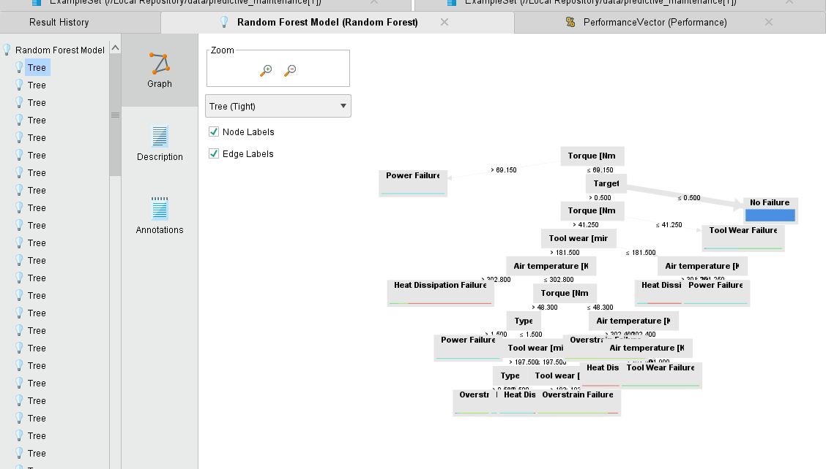
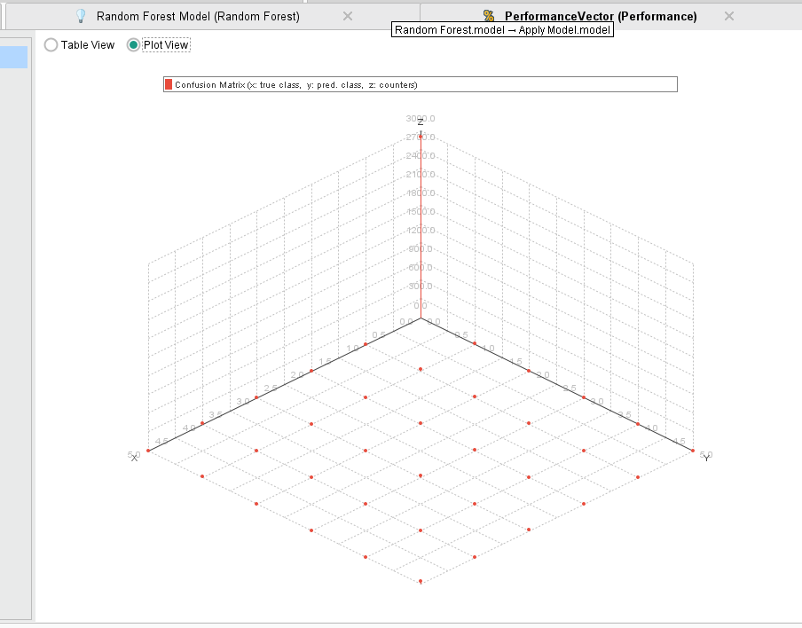
11)Result Analysis: The model's high accuracy rate of 99.30%, highlighting its reliability in predicting machine failures.
Conclusion: Summarize the methodology's effectiveness in accurately classifying machine failures, demonstrating the potential for proactive maintenance and cost savings.
Random Forest Tree
Confusion Matrix Plot

Slide 10

Presented by RISHIT RASTOGI
Thank you very much!
YouTubeLink; https://youtu.be/f1-WWHE4rbA
DataSet Link: https://drive.google.com/file/d/1V4ZK4LGYCQ7FiQXavGaSOiwUGPoy9GNB/view?usp=sharing
For Full Hands on Software demonstration

